Slide 1
Web程式設計
Bootstrap (Responsive Web Design, RWD)
授課教師:陳錫民
Email: hsiminc@fcu.edu.tw

Slide 2
What is Bootstrap?
is a free front-end framework for faster and easier web development
includes HTML and CSS based design templates for typography, forms, buttons, tables, navigation, modals, image carousels and many other, as well as optional JavaScript plugins
also gives you the ability to easily create responsive designs

Slide 3
What is Responsive Web Design?
Responsive web design is about creating web sites which automatically adjust themselves to look good on all devices, from small phones to large desktops.
Top 22 Best Free HTML5 Frameworks for Responsive Web Development 2016
https://colorlib.com/wp/html5-frameworks/

Slide 4
Bootstrap History
Bootstrap was developed by Mark Otto and Jacob Thornton at Twitter, and released as an open source product in August 2011 on GitHub.
In June 2014 Bootstrap was the No.1 project on GitHub!

Slide 5
Why Use Bootstrap?
Advantages of Bootstrap:
Easy to use: Anybody with just basic knowledge of HTML and CSS can start using Bootstrap
Responsive features: Bootstrap's responsive CSS adjusts to phones, tablets, and desktops
Mobile-first approach: In Bootstrap 3, mobile- first styles are part of the core framework
Browser compatibility: Bootstrap is compatible with all modern browsers (Chrome, Firefox, Internet Explorer, Safari, and Opera)

Slide 6
Where to Get Bootstrap?
There are two ways to start using Bootstrap on your own web site.
Download Bootstrap from getbootstrap.com
Include Bootstrap from a CDN

Slide 7
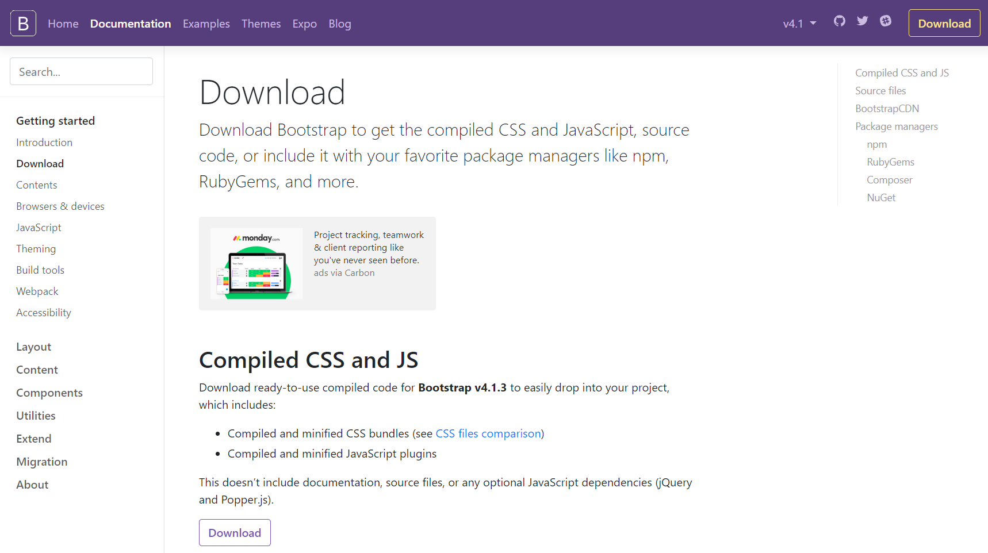
Downloading Bootstrap
https://getbootstrap.com/docs/4.1/getting-started/download/

Slide 8
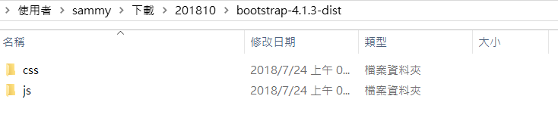
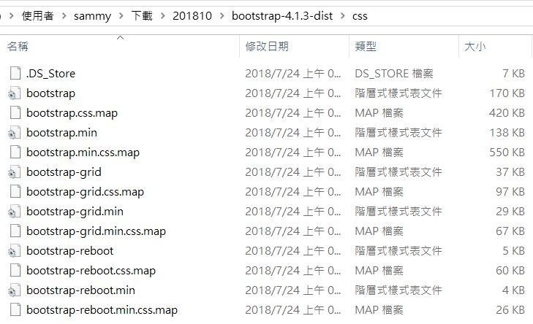
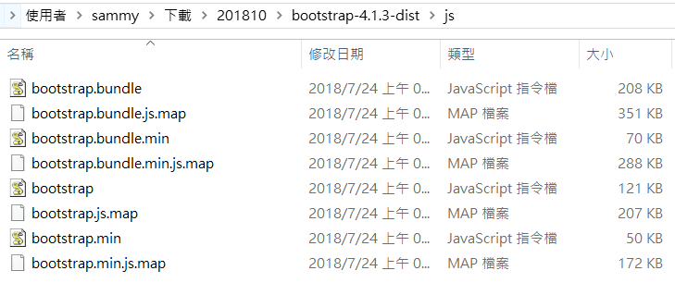

Slide 9
Bootstrap CDN
If you don't want to download and host Bootstrap yourself, you can include it from a CDN (Content Delivery Network)
<link rel="stylesheet" href="https://stackpath.bootstrapcdn.com/bootstrap/4.1.3/css/bootstrap.min.css" integrity="sha384-MCw98/SFnGE8fJT3GXwEOngsV7Zt27NXFoaoApmYm81iuXoPkFOJwJ8ERdknLPMO" crossorigin="anonymous">
<script src="https://code.jquery.com/jquery-3.3.1.slim.min.js" integrity="sha384-q8i/X+965DzO0rT7abK41JStQIAqVgRVzpbzo5smXKp4YfRvH+8abtTE1Pi6jizo" crossorigin="anonymous"></script>
<script src="https://cdnjs.cloudflare.com/ajax/libs/popper.js/1.14.3/umd/popper.min.js" integrity="sha384-ZMP7rVo3mIykV+2+9J3UJ46jBk0WLaUAdn689aCwoqbBJiSnjAK/l8WvCWPIPm49" crossorigin="anonymous"></script>
<script src="https://stackpath.bootstrapcdn.com/bootstrap/4.1.3/js/bootstrap.min.js" integrity="sha384-ChfqqxuZUCnJSK3+MXmPNIyE6ZbWh2IMqE241rYiqJxyMiZ6OW/JmZQ5stwEULTy" crossorigin="anonymous"></script>

Slide 10
Create First Web Page With Bootstrap
Add the HTML5 doctype
Bootstrap uses HTML elements and CSS properties that require the HTML5 doctype.
<!DOCTYPE html>
<html>
<head> <meta charset="utf-8">
</head>
</html>

Slide 11
Create First Web Page With Bootstrap
2. Bootstrap 3 is mobile-first
Bootstrap 3 is designed to be responsive to mobile devices.
The width=device-width part sets the width of the page to follow the screen-width of the device (which will vary depending on the device).
The initial-scale=1 part sets the initial zoom level when the page is first loaded by the browser.
<meta name="viewport" content="width=device-width, initial-scale=1">

Slide 12
Create First Web Page With Bootstrap
3. Containers
Bootstrap also requires a containing element to wrap site contents.
There are two container classes to choose from:
The .container class provides a responsive fixed width container
The .container-fluid class provides a full width container, spanning the entire width of the viewport

Slide 13
Without Bootstrap
<!doctype html>
<html>
<head>
<title>Hello, world!</title>
<!-- Required meta tags -->
<meta charset="utf-8">
</head>
<body>
<h1>Hello, world!</h1>
</body>
</html>

Slide 14
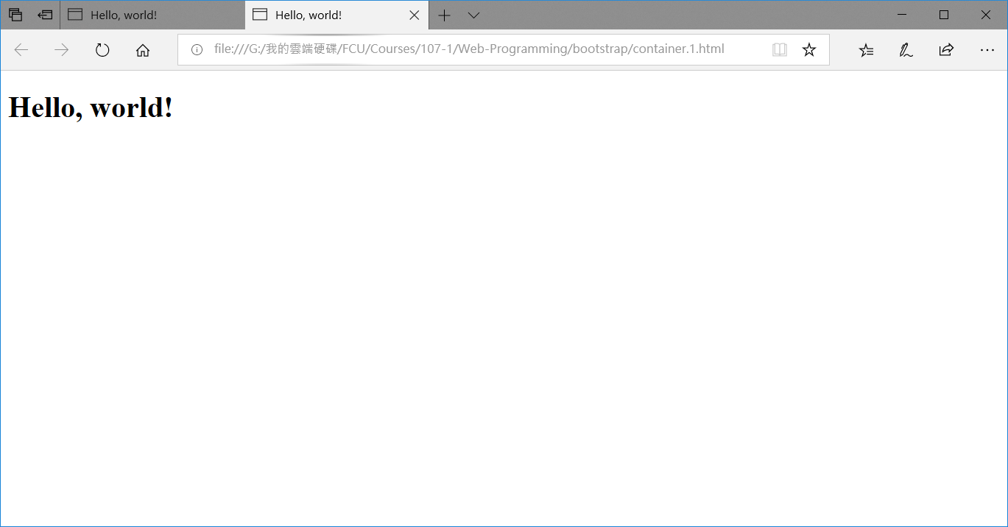
Without Bootstrap

Slide 15
With Bootstrap
<!doctype html>
<html>
<head>
<title>Hello, world!</title>
<!-- Required meta tags -->
<meta charset="utf-8">
<meta name="viewport" content="width=device-width, initial-scale=1, shrink-to-fit=no">
<!-- Bootstrap CSS -->
<link rel="stylesheet" href="https://stackpath.bootstrapcdn.com/bootstrap/4.1.3/css/bootstrap.min.css"
integrity="sha384-MCw98/SFnGE8fJT3GXwEOngsV7Zt27NXFoaoApmYm81iuXoPkFOJwJ8ERdknLPMO“ crossorigin="anonymous">
</head>
<body>
<h1>Hello, world!</h1>
<!-- Optional JavaScript -->
<!-- jQuery first, then Popper.js, then Bootstrap JS -->
<script src="https://code.jquery.com/jquery-3.3.1.slim.min.js"
integrity="sha384-q8i/X+965DzO0rT7abK41JStQIAqVgRVzpbzo5smXKp4YfRvH+8abtTE1Pi6jizo“ crossorigin="anonymous"></script>
<script src="https://cdnjs.cloudflare.com/ajax/libs/popper.js/1.14.3/umd/popper.min.js"
integrity="sha384-ZMP7rVo3mIykV+2+9J3UJ46jBk0WLaUAdn689aCwoqbBJiSnjAK/l8WvCWPIPm49“ crossorigin="anonymous"></script>
<script src="https://stackpath.bootstrapcdn.com/bootstrap/4.1.3/js/bootstrap.min.js"
integrity="sha384-ChfqqxuZUCnJSK3+MXmPNIyE6ZbWh2IMqE241rYiqJxyMiZ6OW/JmZQ5stwEULTy“ crossorigin="anonymous"></script>
</body>
</html>

Slide 16
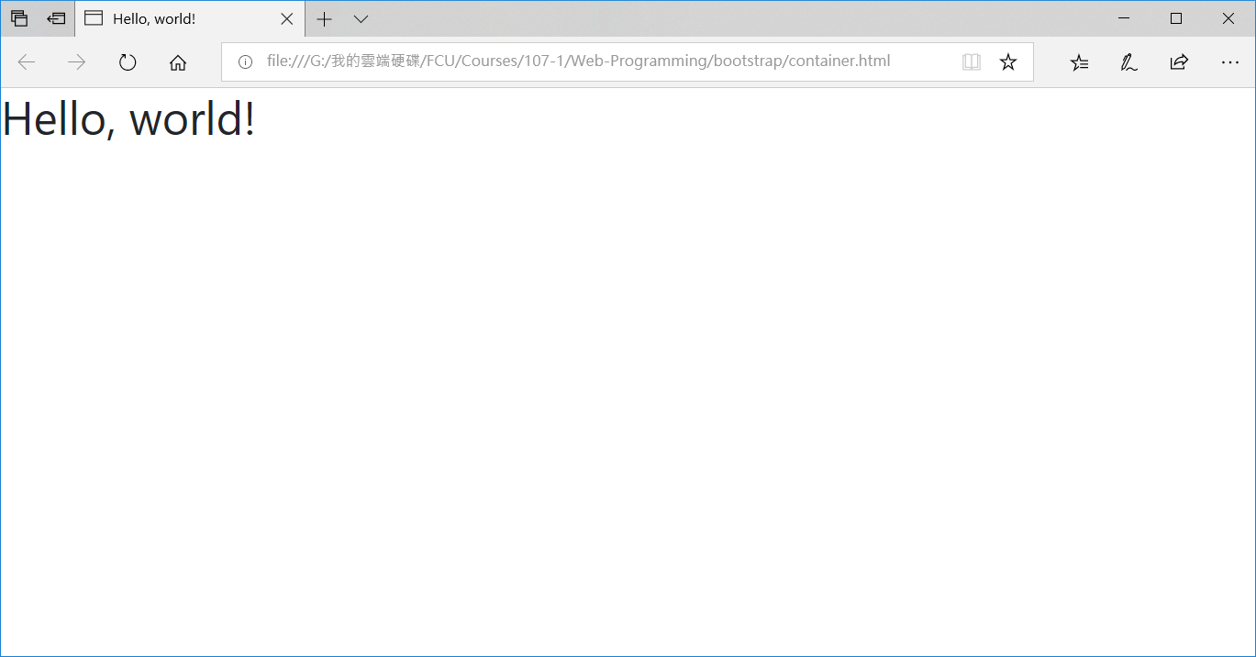

Slide 17
With <div class="container">
<!doctype html>
<html>
<head>
<title>Hello, world!</title>
<!-- Required meta tags -->
<meta charset="utf-8">
<meta name="viewport" content="width=device-width, initial-scale=1, shrink-to-fit=no">
<!-- Bootstrap CSS -->
<link rel="stylesheet" href="https://stackpath.bootstrapcdn.com/bootstrap/4.1.3/css/bootstrap.min.css"
integrity="sha384-MCw98/SFnGE8fJT3GXwEOngsV7Zt27NXFoaoApmYm81iuXoPkFOJwJ8ERdknLPMO“ crossorigin="anonymous">
</head>
<body>
<div class="container">
<h1>Hello, world!</h1>
</div>
<!-- Optional JavaScript -->
<!-- jQuery first, then Popper.js, then Bootstrap JS -->
<script src="https://code.jquery.com/jquery-3.3.1.slim.min.js"
integrity="sha384-q8i/X+965DzO0rT7abK41JStQIAqVgRVzpbzo5smXKp4YfRvH+8abtTE1Pi6jizo“ crossorigin="anonymous"></script>
<script src="https://cdnjs.cloudflare.com/ajax/libs/popper.js/1.14.3/umd/popper.min.js"
integrity="sha384-ZMP7rVo3mIykV+2+9J3UJ46jBk0WLaUAdn689aCwoqbBJiSnjAK/l8WvCWPIPm49“ crossorigin="anonymous"></script>
<script src="https://stackpath.bootstrapcdn.com/bootstrap/4.1.3/js/bootstrap.min.js"
integrity="sha384-ChfqqxuZUCnJSK3+MXmPNIyE6ZbWh2IMqE241rYiqJxyMiZ6OW/JmZQ5stwEULTy“ crossorigin="anonymous"></script>
</body>
</html>

Slide 18
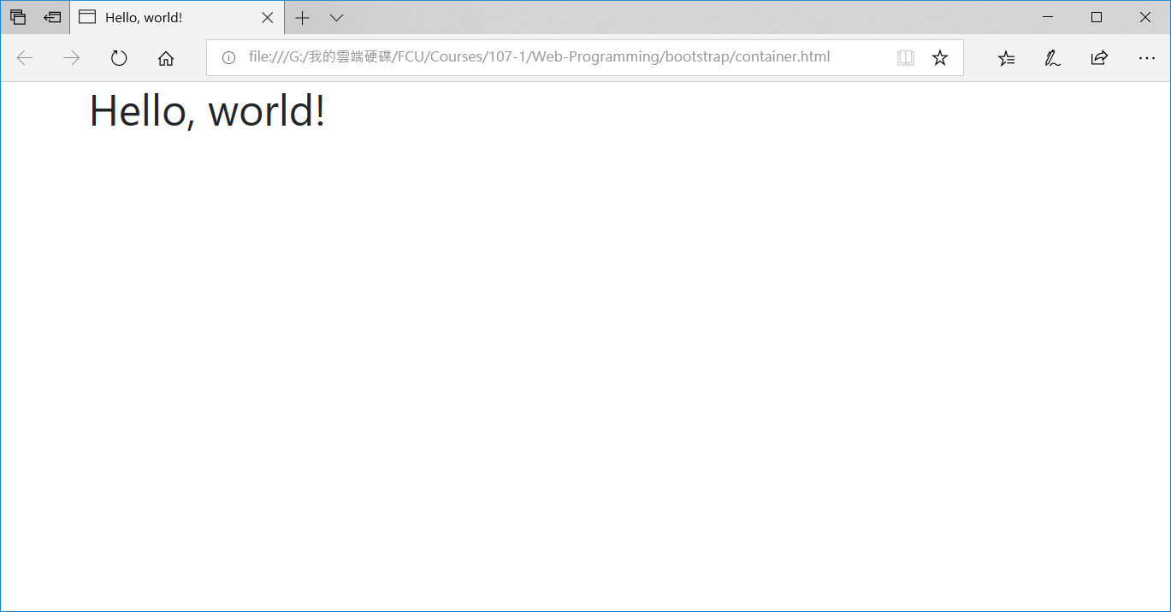
With <div class="container">

Slide 19
<div class="container-fluid">
<!doctype html>
<html>
<head>
<title>Hello, world!</title>
<!-- Required meta tags -->
<meta charset="utf-8">
<meta name="viewport" content="width=device-width, initial-scale=1, shrink-to-fit=no">
<!-- Bootstrap CSS -->
<link rel="stylesheet" href="https://stackpath.bootstrapcdn.com/bootstrap/4.1.3/css/bootstrap.min.css"
integrity="sha384-MCw98/SFnGE8fJT3GXwEOngsV7Zt27NXFoaoApmYm81iuXoPkFOJwJ8ERdknLPMO“ crossorigin="anonymous">
</head>
<body>
<div class="container-fluid">
<h1>Hello, world!</h1>
</div>
<!-- Optional JavaScript -->
<!-- jQuery first, then Popper.js, then Bootstrap JS -->
<script src="https://code.jquery.com/jquery-3.3.1.slim.min.js"
integrity="sha384-q8i/X+965DzO0rT7abK41JStQIAqVgRVzpbzo5smXKp4YfRvH+8abtTE1Pi6jizo“ crossorigin="anonymous"></script>
<script src="https://cdnjs.cloudflare.com/ajax/libs/popper.js/1.14.3/umd/popper.min.js"
integrity="sha384-ZMP7rVo3mIykV+2+9J3UJ46jBk0WLaUAdn689aCwoqbBJiSnjAK/l8WvCWPIPm49“ crossorigin="anonymous"></script>
<script src="https://stackpath.bootstrapcdn.com/bootstrap/4.1.3/js/bootstrap.min.js"
integrity="sha384-ChfqqxuZUCnJSK3+MXmPNIyE6ZbWh2IMqE241rYiqJxyMiZ6OW/JmZQ5stwEULTy“ crossorigin="anonymous"></script>
</body>
</html>

Slide 20
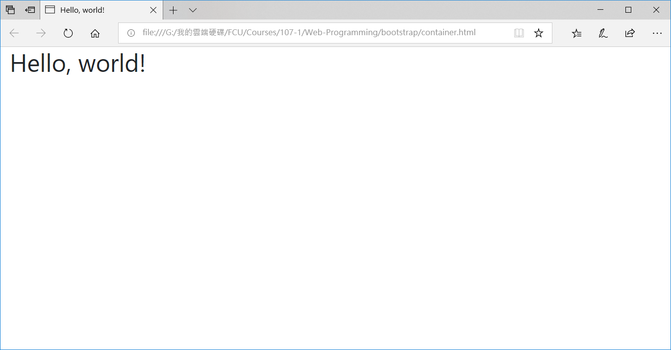
<div class="container-fluid">

Slide 21
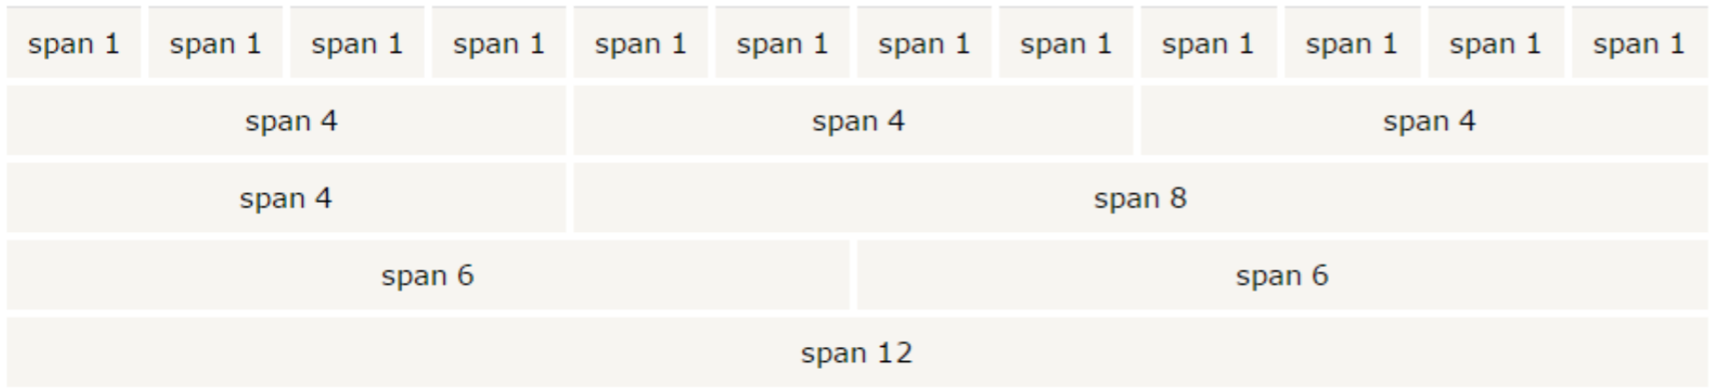
Bootstrap Grid System
Bootstrap's grid system allows up to 12 columns across the page.
Bootstrap's grid system is responsive, and the columns will re-arrange automatically depending on the screen size.
If you do not want to use all 12 columns individually, you can group the columns together to create wider columns:

Slide 22
Grid Classes
The Bootstrap grid system has four classes:
xs (for phones)
sm (for tablets)
md (for desktops)
lg (for larger desktops)

Slide 23
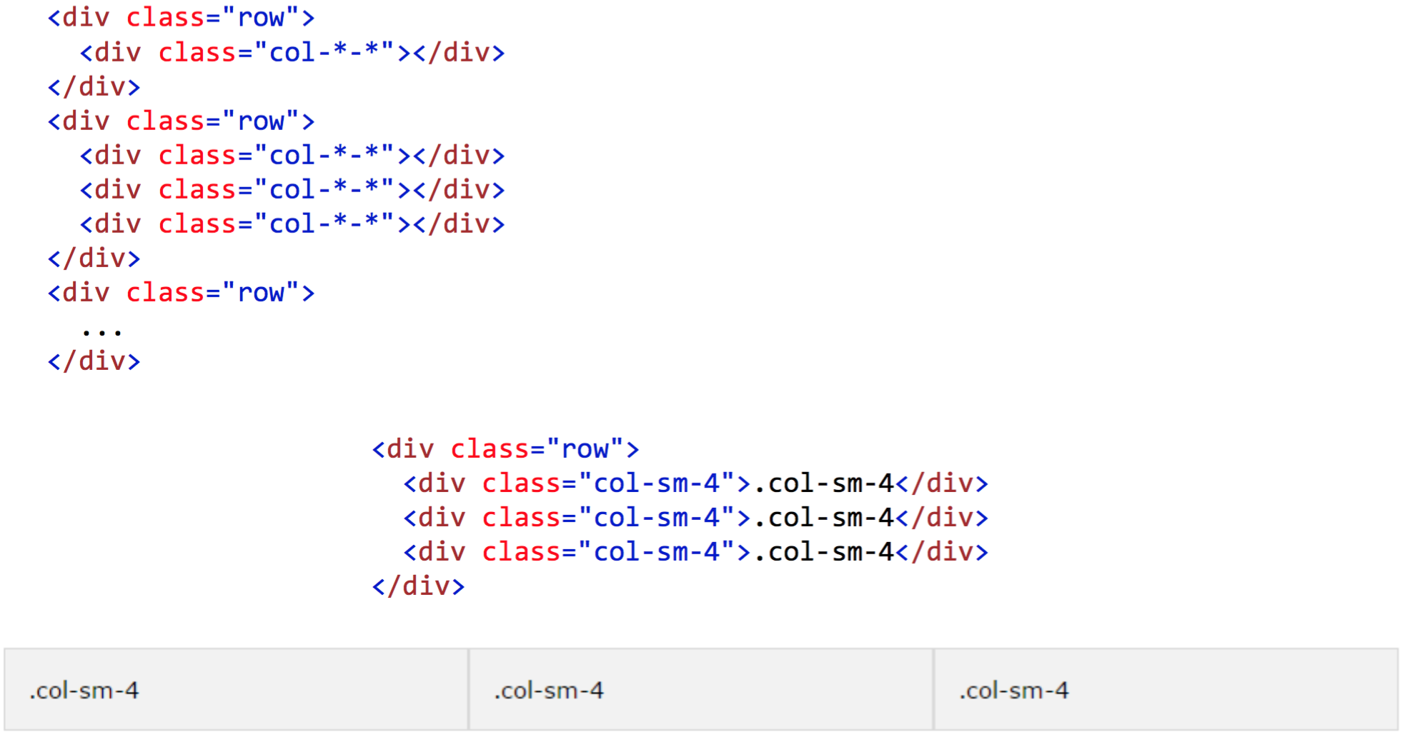
Basic Structure of a Bootstrap Grid

Slide 24
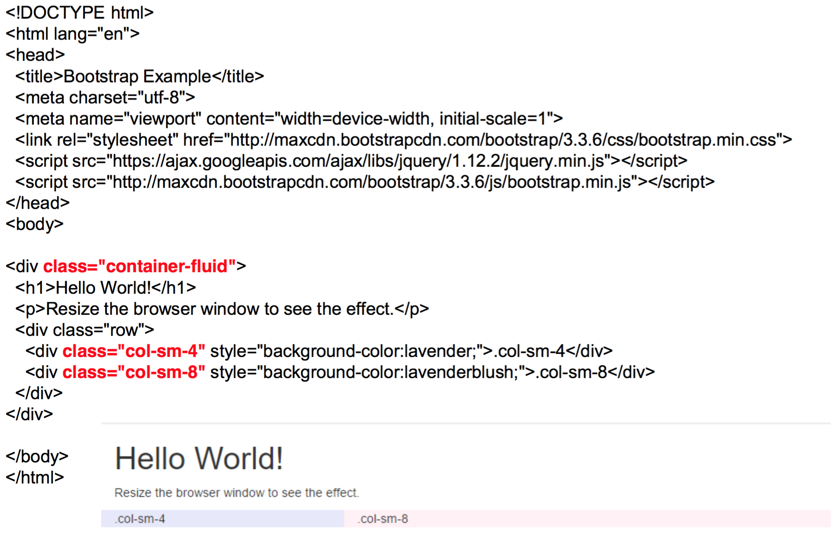

Slide 25
Bootstrap Text/Typography
Bootstrap's Default Settings
Bootstrap's global default font-size is 14px, with a line-height of 1.428.
This is applied to the <body> and all paragraphs
http://www.w3schools.com/bootstrap/bootstrap_ty pography.asp

Slide 26
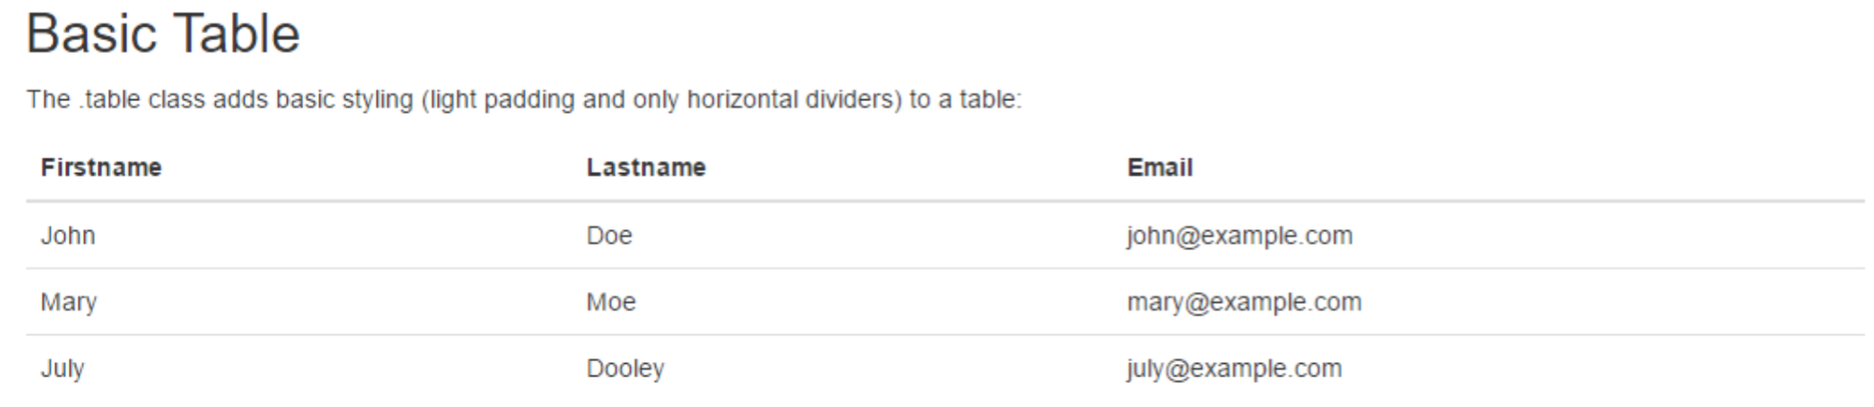
Bootstrap Basic Table
A basic Bootstrap table has a light padding and only horizontal dividers.
The .table class adds basic styling to a table:
http://www.w3schools.com/bootstrap/bootstrap_t ables.asp

Slide 27
Bootstrap Images
Bootstrap Image Shapes
Responsive Images
Responsive images automatically adjust to fit the size of the screen
Image Gallery
use Bootstrap's grid system in conjunction with the .thumbnail class to create an image gallery
Responsive Embeds
http://www.w3schools.com/bootstrap/bootstrap_i mages.asp

Slide 28
Bootstrap Wells
The .well class adds a rounded border around an element with a gray background color and some padding:
http://www.w3schools.com/bootstrap/bootstrap_ wells.asp

Slide 29
Bootstrap Buttons
Bootstrap provides seven styles of buttons:
.btn-default
.btn-primary
.btn-success
.btn-info
.btn-warning
.btn-danger
.btn-link
http://www.w3schools.com/bootstrap/boots trap_buttons.asp

Slide 30
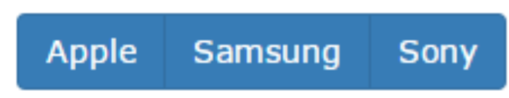
Bootstrap Button Groups
Bootstrap allows you to group a series of buttons together (on a single line) in a button group:
Use a <div> element with class .btn-group to create a button group:
http://www.w3schools.com/bootstrap/bootstrap_button_g roups.asp

Slide 31
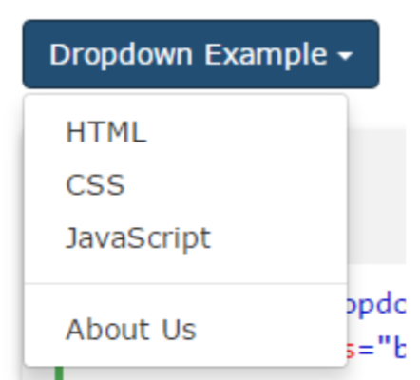
Bootstrap Dropdowns
A dropdown menu is a toggleable menu that allows the user to choose one value from a predefined list:
http://www.w3schools.com/bootstrap/bootstrap_ dropdowns.asp

Slide 32
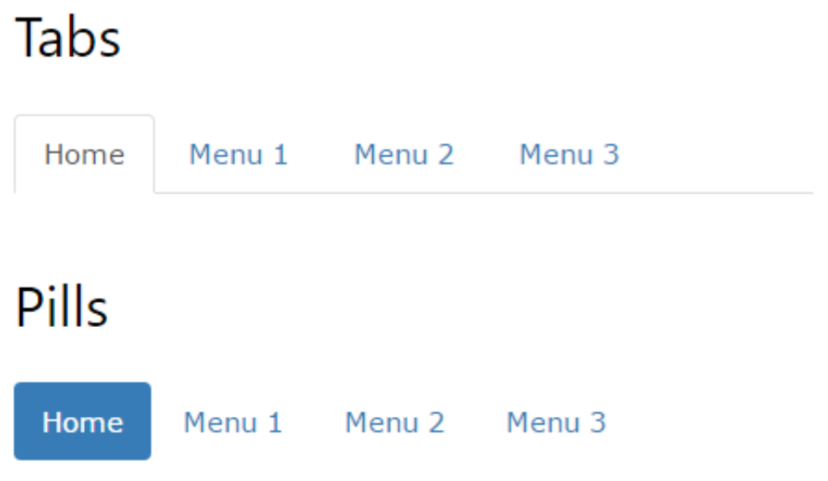
Bootstrap Tabs and Pills
http://www.w3schools.com/bootstrap/bootstrap_t abs_pills.asp

Slide 33
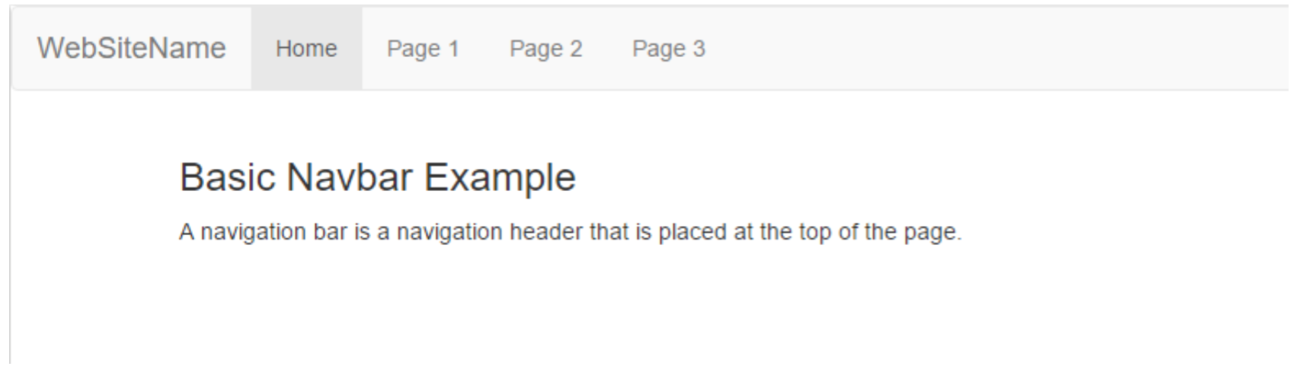
Bootstrap Navigation Bar
A navigation bar is a navigation header that is placed at the top of the page:
http://www.w3schools.com/bootstrap/bootstrap_ navbar.asp

Slide 34
Bootstrap Forms
All textual <input>, <textarea>, and <select> elements with class .form-control have a width of 100%.
Bootstrap provides three types of form layouts:
Vertical form (this is default)
Horizontal form
Inline form
http://www.w3schools.com/bootstrap/boots trap_forms.asp

Slide 35
Bootstrap Carousel Plugin
The Carousel plugin is a component for cycling through elements, like a carousel (slideshow).
http://www.w3schools.com/bootstrap/bootstrap_ carousel.asp

Slide 36
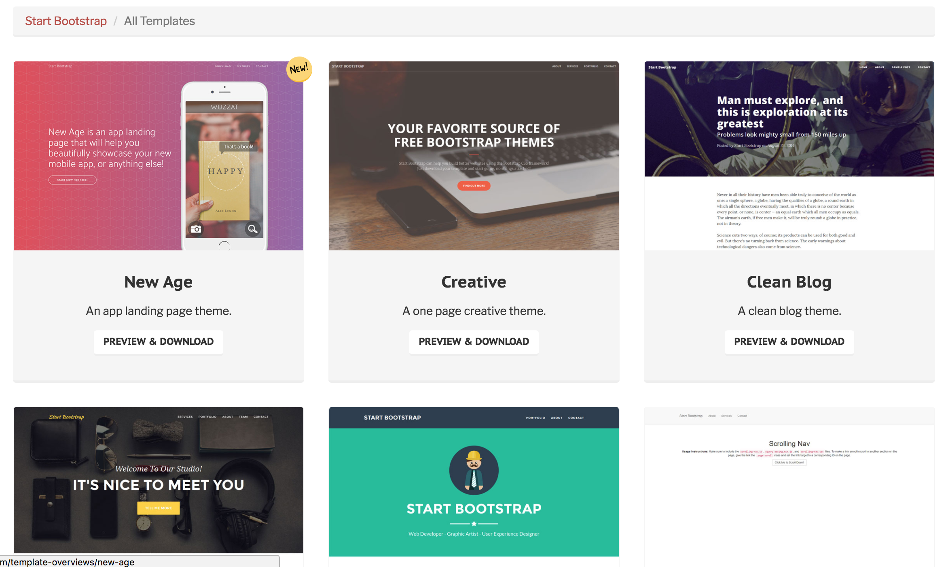
Theme Templates
https://startbootstrap.com/template-categories/all/

Slide 37
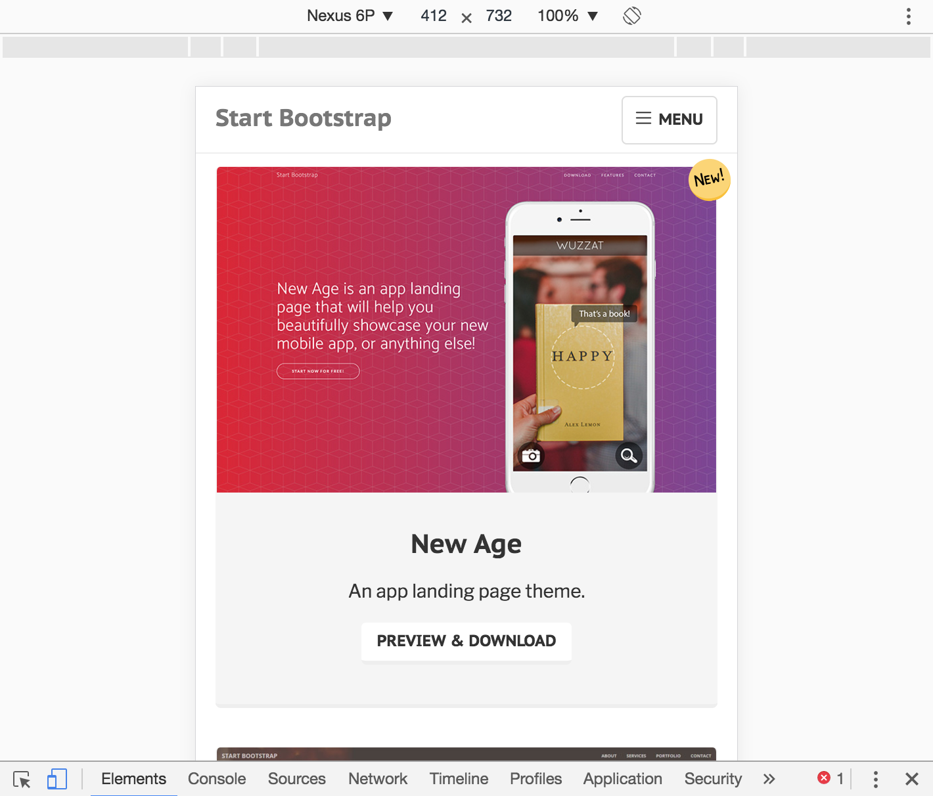
Check out Mobile View

